Slide 1
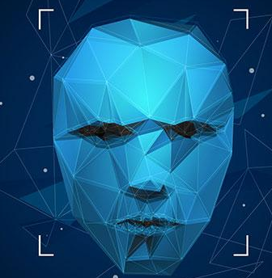
UNIT III
FACE RECOGNITION AND HAND GESTURE RECOGNITION

Slide 2
Introduction to face recognition
Face recognition is a technology that identifies or verifies a person's identity using their face.
Facial recognition is a way of identifying or confirming an individual’s identity using their face.
Facial recognition systems can be used to identify people in photos, videos, or in real-time.
Face recognition is the automated comparison of one face image and one or more other face images for the sake of establishing or verifying identity

Slide 3
Introduction to face recognition
These faces could be
Two Dimensional (like a selfie) or
Three Dimensional (like from a specialized sensor on a smartphone)
Photo (like a passport) or a
Video (like from a security camera), they could be from a
Basic Camera (like a webcam) or a
Dedicated Reader (like an airport eGate terminal).

Slide 4
Working of Facial Recognition
Many people are familiar with face recognition technology through the FaceID used to unlock Phones
Step 1: Face detection : The camera detects and locates the image of a face, either alone or in a crowd. The image may show the person looking straight ahead or in profile.
Step 2: Face analysis: Next, an image of the face is captured and analyzed. Most facial recognition technology relies on 2D rather than 3D images because it can more conveniently match a 2D image with public photos or those in a database.
The software reads the geometry of your face. Key factors include
The distance between your eyes,
The depth of your eye sockets,
The distance from forehead to chin,
The shape of your cheekbones, and
The contour of the lips, ears, and chin.
The aim is to identify the facial landmarks that are key to distinguishing your face.

Slide 5
Step 3: Converting the image to data/ Template Creation
The face capture process transforms analog information (a face) into a set of digital information (data) based on the person's facial features. Your face's analysis is essentially turned into a mathematical formula.
Step 4: Finding a match/ Template comparison
Face matching happens by comparing two templates.
Your faceprint is then compared against a database of other known faces. For example, the FBI has access to up to 650 million photos, drawn from various state databases.
On Facebook/ Instagram , any photo tagged with a person’s name becomes a part of Facebook's database, which may also be used for facial recognition.
It is estimated that over half of the world's population is touched by facial recognition technology regularly.
Technique of Template Comparison
As the templates are actually just vectors, template comparison is accomplished by calculating the distance between these two vectors using an equation like Euclidian distance or similar calculation. The closer the distance, the closer the match between the templates.

Slide 6
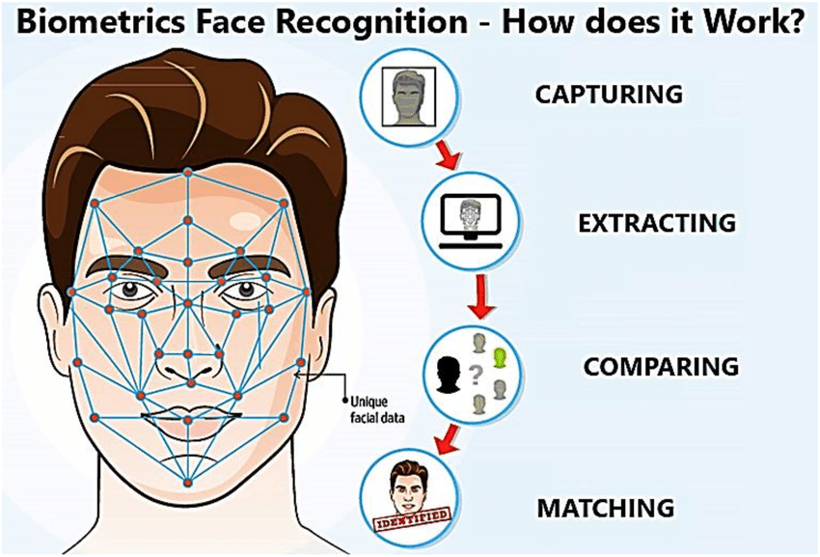

Slide 7
Application of Facial Recognition
Security: Access control (e.g., unlocking phones, accessing buildings).
Law Enforcement: Identifying suspects, surveillance.
Mobile Technology: Unlocking phones, verifying payments, photo organization.
Retail: Enhancing customer service, fraud detection.
Finance: Digital onboarding, fraud prevention.
Airports and border control
Finding missing persons: To find missing persons and victims of human trafficking
Marketing and advertising
Healthcare: Hospitals use facial recognition to help with patient care.
Tracking student or worker attendance

Slide 8
History & Evolution
Development began on similar systems in the 1960s, beginning as a form of computer application. Designed to measure and pinpoint facial features with a view to identifying them from a collection of faces on a database
Facial recognition as a concept, however, was formally pioneered in 1964 by computer scientists and mathematicians, Woody Bledsoe, Charles Bisson, and Helen Chan Wolf. However much of their initial work was never made public, due to the secret nature of its funding from an unnamed intelligence agency.
By the 1970s, facial recognition accuracy was coming on in leaps and bounds with aspects such as hair color, lip shape, and other key identifying areas
A key milestone came in 2001 when law enforcement in the US used facial recognition for the very first time to help identify Super Bowl spectators potentially causing disruption or harm.

Slide 9
Technologies used in Facial Recognition
Artificial Intelligence (AI): AI, particularly machine learning and deep learning algorithms, is at the heart of modern facial recognition systems.
Computer Vision: This field of AI is concerned with how computers can gain high-level understanding from digital images or videos.
Biometric Analysis: Biometrics refers to the statistical analysis of biological data, which in the case of facial recognition is the unique features of the face.
Neural Networks: Particularly, convolutional neural networks (CNNs) are used for image recognition tasks and are crucial for the feature extraction phase in facial recognition systems.

Slide 10
Face Recognition Algorithms
Convolutional Neural Network (CNN)
Deep learning model with multiple convolutional and pooling layers.
Learns to extract and process image features directly.
Widely used in modern face recognition systems.
Eigenfaces
Uses Principal Component Analysis (PCA) to represent faces statistically.
Converts facial features into eigenvalues to measure variance.
Simple and fast, but sensitive to lighting and expressions.
Fisher faces
Extension of Eigenfaces using Linear Discriminant Analysis (LDA).
Takes class labels into account.
Performs well with varying lighting and facial expressions.
DeepFace (by Facebook)
CNN-based model trained on 4 million+ images.
Achieved human-level accuracy on some datasets.
Extracts features and compares via deep embeddings.

Slide 11
Face Recognition Algorithms
Principal Component Analysis (PCA)
Reduces data dimensionality while retaining important info.
Creates eigenfaces from weighted eigenvectors.
Foundational technique for statistical face recognition.
Haar Cascades
Feature-based object detection algorithm.
Trained to detect specific facial features (eyes, nose, etc.).
Useful for face detection in real-time applications.
Three-Dimensional Recognition
Analyzes 3D geometry of the skull and facial structure.
Recognizes faces despite occlusions like glasses or facial hair.
More robust than 2D techniques.
Skin Texture Analysis
Studies skin details like freckles, moles, and texture.
Requires high-resolution images for best performance.
Effective even with hairstyle changes or accessories.

Slide 12
Face Recognition Algorithms
ANFIS (Adaptive Neuro-Fuzzy Inference System)
  Combines neural networks and fuzzy logic.
  Classifies features during preprocessing.
  Speeds up recognition with adaptive feature interpretation.
Local Binary Patterns Histograms (LBPH)
  Analyzes local pixel patterns relative to neighbors.
  Generates histograms for facial data comparison.
  Lightweight and effective in low-complexity systems.
FaceNet (by Google)
  Maps faces to a Euclidean space using embeddings.
  Measures face similarity by distance between embeddings.
  Accurate and widely adopted in commercial systems.
Face++ (by Megvii)
  Combines graph detection and fuzzy search.
  Built on proprietary MegEngine deep learning framework.
  Includes features like tracking, clustering, and info extraction.
Support Vector Machine (SVM)
  Machine learning classifier using kernel methods.
  Effective in distinguishing facial features.
  Works well when combined with feature extraction techniques.

Slide 13
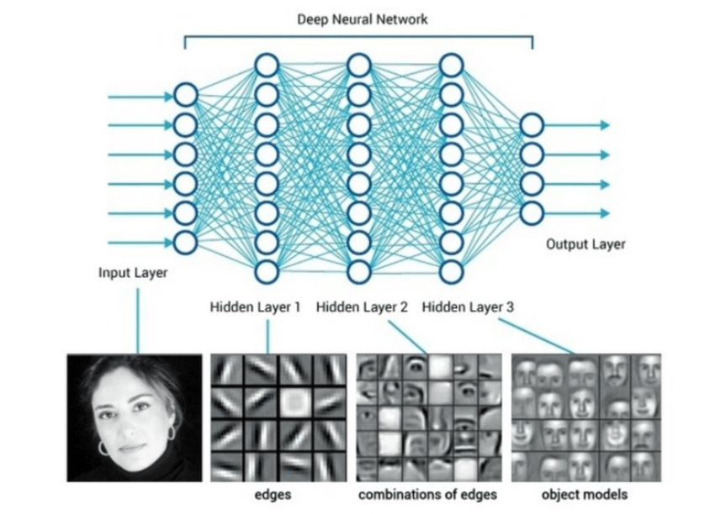
Neural networks in face recognition

Slide 14
Neural Networks Work for Face Recognition
1. Input Processing:
A neural network takes a facial image as input.
2. Feature Extraction:
Deep networks, especially CNNs, are designed with multiple layers that automatically learn to identify key features from the image, such as facial contours, shapes, and textures.
3. Feature Representation:
The network creates a unique numerical representation, or "embedding," for each face, which captures its most distinctive characteristics.
4. Classification/Matching:
This feature representation is then compared against a database of known faces to find the best match.

Slide 15
Neural networks in face recognition
In face recognition, neural networks, are used to analyze images and extract key facial features like edges, outlines, and specific features such as eyes and nose.
Powerful and robust classification technique used for both:
Known data (training data)
Unknown data (unseen/test data)
Works effectively with:
Linear datasets
Non-linear separable datasets
Applications include:
Speech recognition
Face recognition
Fingerprint recognition
Iris recognition

Slide 16
Neural networks in face recognition
Artificial Neural Network (ANN) is made up of:
  Artificial neurons (nodes) connected in a network
Connection strength between nodes is assigned a value:
  Excitation: up to +1.0 (strong positive influence)
  Inhibition: down to -1.0 (strong negative influence)
  Higher value = stronger connection
(Excitation Up to 1.0)
Feature Enhancement: When the input data (a face image) arrives, excitation would strongly activate neurons that are responsible for recognizing features like the eyes, nose, or mouth.
Increased Importance: A value of "1.0" for excitation would suggest a maximum or strong positive contribution, amplifying the signal of these important features, making them more prominent for the network.
(Inhibition Down to 1.0):
Noise Reduction: Inhibition is used to suppress irrelevant information, such as shadows, background clutter, or changes in facial expression that are not relevant to individual identification.
Selective Processing: A strong negative influence (where "down to 1.0" might imply a maximum suppression) ensures that the network focuses only on the core facial features, preventing these other variables from interfering with the recognition task.

Slide 17
Neural networks in face recognition
Types of nodes in ANN:
  Input nodes – receive raw data
  Hidden nodes – perform internal computation
  Output nodes – deliver final predictions or classifications
Flow of Information in a Neural Network
Input nodes receive information as numeric values (activation values).
Higher activation value = stronger activation of the node.
Information is passed through the network based on:
  Connection strengths (weights)
  Inhibition (-1.0) or excitation (+1.0)
  Transfer functions within nodes
Each node:
  Sums incoming activation values
  Modifies them using its transfer function
Activation flows through hidden layers of the network.
Final activation reaches the output nodes, which produce meaningful results (e.g., classifications or predictions).

Slide 18
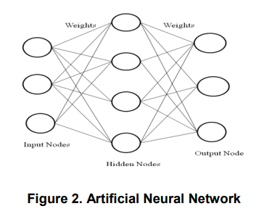

Slide 19
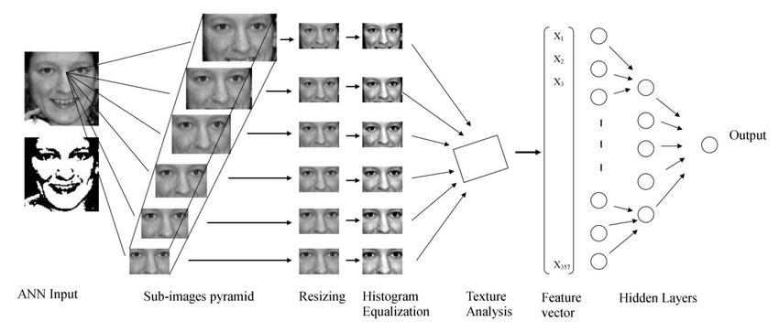

Slide 20
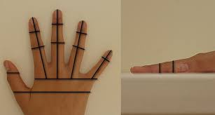
Basics of Hand geometry
Hand geometry is a biometric system that verifies a person's identity by measuring unique physical characteristics of their hand, such as finger lengths, widths, and palm dimensions.
It is a user-friendly, low-cost, and easily accepted technology for medium-security applications like access control and time-and-attendance systems.
The process involves capturing an image of the hand, extracting features to create a unique template, and then comparing this template against a database to verify identity.

Slide 21
Evolution of Hand Geometry Devices
1970s: Inception
Robert Miller (1971):
  Patented the first automated hand geometry device at the Stanford Research Institute.
  His system used hand measurements combined with a punched ID card to match identity and activate a circuit.
  This marked the first computerized use of biometrics via hand geometry.
Advancements in 3D Hand Scanning
David Sidlauskas:
  Developed the Handkey ID3D, the first 3D hand scanner.
  Included:
    Optical measuring plate
    Camera
    Numeric keypad (for PIN input)
Academic Contributions
Jain et al.:
  One of the earliest academic studies.
  Designed a prototype hand geometry system using 16 geometric features for identity verification.

Slide 22
Basics of Hand geometry
Key Principles
Unique Measurements:
The system relies on the fact that each human hand has a unique shape, including the lengths, widths, thicknesses, and relative positions of fingers and palms.
Feature Extraction:
A camera or scanner captures an image of the hand, and the system extracts key geometric features to create a digital template.
Verification Process:
During verification, the captured hand's features are compared against the stored template to confirm the user's identity.

Slide 23
Basics of Hand geometry
Capture: A user places their hand on a platform with a camera or scanner.
Feature Extraction: The system records the image and analyzes it to measure specific features like finger lengths, finger widths at different points, and palm dimensions.
Template Creation: A digital template is created from these measurements, which represents the individual's unique hand geometry.
Enrollment: The user's template is stored in a database during the enrollment phase.
Verification: When the user presents their hand, a new template is created and compared to their stored template to confirm their identity.

Slide 24
Basics of Hand geometry
Based on the data used for personal identification, technologies for reading human hand can be divided in three categories:
Palm technology,
Hand vein technology,
Hand geometry and hand shape technology.
. Palm Technology – The Classic Approach
Relation to Fingerprint Biometrics (Dactyloscopy):
  Considered an extension of fingerprint analysis.
  Uses similar techniques to fingerprint recognition.
Identification Features:
  Measures:
    Size, shape, and flow of papillae (skin ridges)
    Minutiae points (ridge endings, bifurcations, etc.)
  Preprocessing involves:
    Image normalization
    Conversion to binary image
    Measuring distances between papillae

Slide 25
Palm Technology
Challenges:
  Lighting variations during image capture affect accuracy.
  Solution: Divide palm into five anatomical/functional regions to aid consistency in analysis.
Palm Areas for Image Processing (used in biometrics)
While the palm medically has three muscle-based regions, for biometric image processing, it is often divided into five zones:
Lower Palm
Middle Palm
Upper Palm
Thenar (area at the base of the thumb)
Hypothenar (area at the base of the little finger)
🔍 Note: These regions help localize features and normalize lighting and orientation for accurate palmprint recognition.

Slide 26
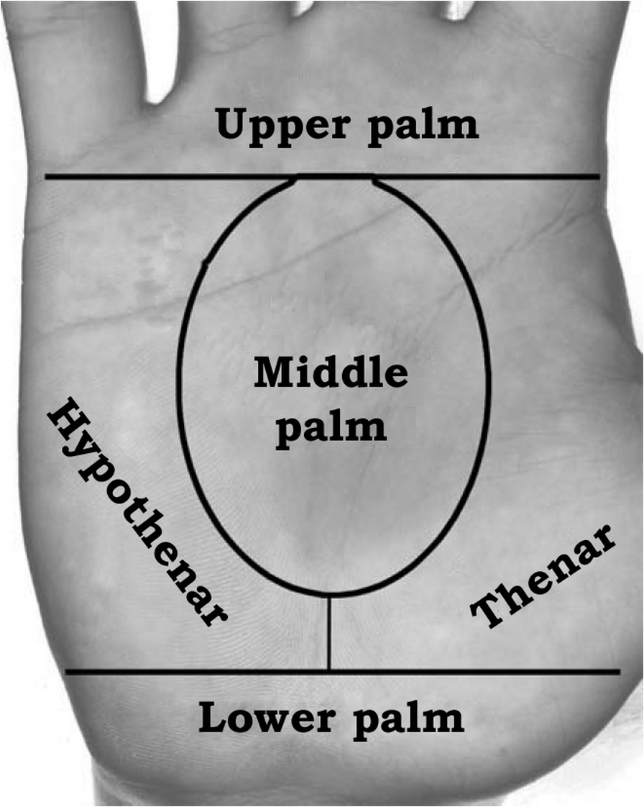
Medically, palm has 3 muscle regions —
but 5 zones are used in biometric analysis for better image consistency.

Slide 27
Hand vein technology
Hand vein technology, particularly palm vein recognition, uses near-infrared light to scan the unique patterns of blood vessels beneath the skin of the palm or finger for biometric authentication.
It is a contactless, highly accurate, and secure method for identifying individuals by comparing a captured vein pattern to a stored template, offering high user acceptance due to its hygiene and non-invasive nature.

Slide 28
Working
Infrared Light Emission: A scanner emits near-infrared light towards the user's palm.
Light Absorption by Hemoglobin: The deoxygenated hemoglobin in the palm's veins absorbs this infrared light, while the surrounding tissue reflects it.
Vein Pattern Image Capture: The scanner captures the reflected light, which reveals the unique, dark pattern of the veins, as the absorbed light makes the veins appear distinct.
Data Conversion and Storage: This captured image of the vein pattern is then digitized, encrypted, and stored as a unique template in a database for future comparison.
Authentication and Verification: When a user attempts to gain access, their palm vein pattern is scanned again. The newly captured image is processed and compared against the previously stored template in the database to verify identity.

Slide 29
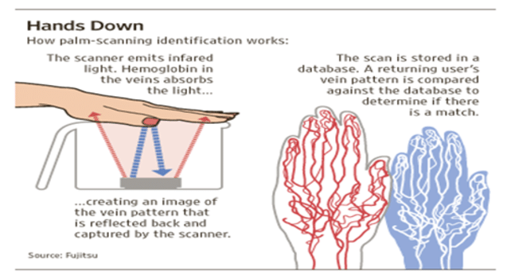

Slide 30
Hand vein technology
Key Features
Contactless:
The process does not require direct physical contact with the scanner, ensuring high levels of hygiene.
Accuracy:
Vein patterns are complex and unique to each individual, even twins, leading to very low false acceptance and rejection rates.
Security:
Vein patterns are internal to the body, making them extremely difficult to forge.
Non-invasive:
It is a non-intrusive method, promoting user acceptance.
Durability:
The vein pattern remains constant throughout a person's lifetime, ensuring consistent identification.

Slide 31
Hand geometry and hand shape technology.
Hand Geometry Technology
Hand geometry technology measures and analyzes the shape, size, and dimensions of a person’s hand, including fingers, palm, and overall structure.
Key Features:
Measures:
  Length and width of fingers
  Width of palm
  Thickness of the hand
  Distance between knuckles
Uses a camera or scanner to capture a 2D or 3D image.
Converts measurements into a numerical template for identity verification.

Slide 32
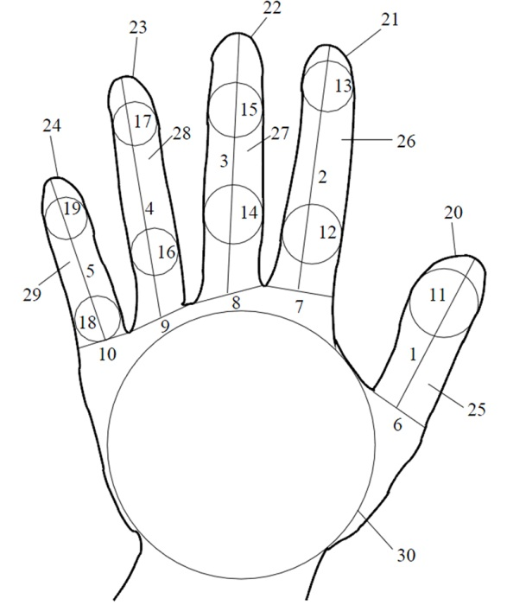
Every human hand is unique. In 2002, thirty global features of hand geometry were defined
Thumb length
Index finger length
Middle finger length
Ring finger length
Pinkie length
Thumb width
Index finger width
Middle finger width
Ring finger width
Pinkie width
Thumb circle radius
Index circle radius lower
Index circle radius upper
Middle circle radius lower
Middle circle radius upper
Ring circle radius lower
Ring circle radius upper
Pinkie circle radius lower
Pinkie circle radius upper
Thumb perimeter
Index finger perimeter
Middle finger perimeter
Ring finger perimeter
Pinkie perimeter
Thumb area
Index finger area
Middle finger area
Ring finger area
Pinkie area
Largest inscribed circle radius

Slide 33
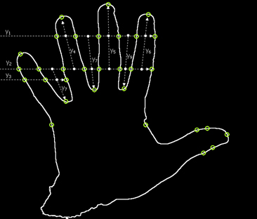
Hand Shape Technology
Hand shape technology is similar to hand geometry but focuses more broadly on the outline or contour of the hand, possibly using a more visual or image-based recognition process.
May use 2D images or depth sensors to analyze the shape of the hand.
Focuses more on the silhouette or outer boundary than internal measurements.
Sometimes used in gesture recognition or human-computer interaction (e.g., gaming, VR).

Slide 34
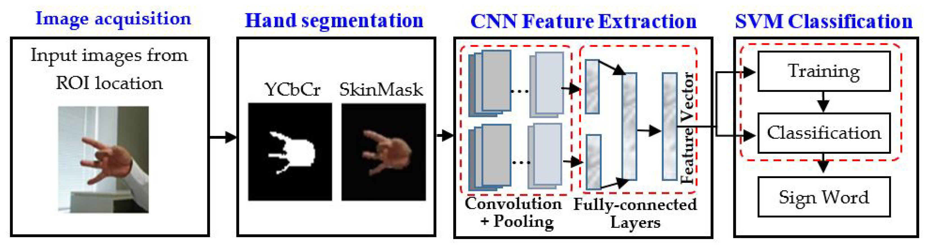

Slide 35
Hand Segmentation - Adaptive Classifiers
Hand segmentation using adaptive classifiers involves dynamically adjusting the classification process to improve accuracy under varying conditions, such as changing light or background.
Adaptive methods often utilize online learning or active learning to continuously update skin color models and feature extractors, enhancing robustness for real-time hand and gesture recognition systems.
Techniques like boosted classifiers, deep learning models (e.g., UNet), and particle filters can be adapted for improved performance in these applications.
Adaptive classifiers in biometrics are systems designed to automatically adjust their recognition models to improve performance over time by adapting to changes in user behavior, environmental conditions, or the inherent variability of biometric traits, a phenomenon known as template aging.

Slide 36
Adaptive Skin Color Models:
Instead of relying on a static skin color model, these systems learn and adapt to changes in illumination and other environmental factors in real-time. This is often achieved through online adaptation, where the model continuously updates its parameters based on incoming image frames.
Active Learning:
This technique allows the system to intelligently request labels for the most informative samples, leading to more efficient training and better performance with fewer annotated data points.
Dynamic Feature Extraction:
Adaptive systems can adjust feature extraction parameters based on the input, such as using adaptive weighted SIFT (Scale-Invariant Feature Transform) to maximize variance in hand data points.
Online Adaptation for Tracking:
For hand tracking, techniques like Sequential Monte Carlo or particle filters can be used to efficiently track fingertips, adapting to changes in their positions and orientations.

Slide 37
Working
Adaptive biometric systems typically use one or more of the following strategies:
Reference Modeling/Template Update:
The system automatically updates the stored reference template using new genuine user samples to reflect current biometric characteristics.
Adaptive Behavior Modification:
The system can change its own behavior, such as deactivating a specific biometric modality (like face recognition under poor lighting) or adjusting the processing steps based on environmental cues.
Adaptive Ensemble Selection:
In multimodal biometric systems, the system can dynamically select the most competent classifier or combination of classifiers for a given user or set of biometric samples.
Incremental Learning:
The classifier is continuously or periodically retrained with new data streams to learn from changes, for instance, by adapting the meta-classifier in an ensemble approach.

Slide 38
Key applications
Adaptive classification for hand segmentation is a critical component in systems for:
Hand Gesture Recognition: This is a major application, with gestures being interpreted as either static hand signs or dynamic hand movements. Accurate, real-time segmentation is the foundation for recognizing these gestures.
Human-Robot Interaction (HRI): In industrial and collaborative settings, adaptive hand segmentation ensures safety by allowing robots to accurately track human hands. Models are trained on large datasets but must adapt to new, real-world conditions to work reliably.
Medical Applications: The technique has been used for specialized segmentation tasks, such as diagnosing health conditions based on hand images in traditional Chinese medicine.
Virtual and Augmented Reality (VR/AR): Adaptive segmentation enables immersive, touchless interaction by correctly interpreting hand movements and occlusion in a virtual space.
Assistive Communication: Researchers have developed systems that use machine learning to adaptively recognize hand gestures for people with communication disorders.

Slide 39
Visual-Based Feature Extraction and Pattern Classification
Visual-based hand geometry involves capturing an image of a hand to extract its unique shape features, such as finger lengths, widths, and palm size, which are then used to classify individuals.
Preprocessing techniques like noise reduction and contrast enhancement are applied to the image, followed by feature extraction methods to isolate key geometric points and curves.
Finally, these extracted features are fed into pattern recognition classifiers, such as neural networks, to identify and verify individuals.

Slide 40
The process involves capturing an image of a hand, extracting unique geometric features, and using a classification algorithm to verify an individual's identity by comparing the extracted features to a stored template
Image acquisition:
An optical scanner or a digital camera captures an image of a user's hand.
  Peg-based systems: Some older systems use pegs on a flat surface to guide hand placement for consistent image capture.
  Peg-free systems: Modern systems are more flexible and use sophisticated image processing to achieve alignment without physical guides.
Preprocessing:
The raw image is refined for feature extraction.
  Image segmentation: The hand contour is isolated from the background, often by converting the image to grayscale and applying a thresholding technique.
  Noise removal: Filters are used to reduce noise and enhance image contrast.
  Alignment: Images are rotated or translated so they are consistently oriented for feature measurement.

Slide 41
Feature extraction: Key geometric characteristics are measured from the preprocessed image.
  Measurements: Common features include finger lengths, finger widths at different points, palm width, palm diameter, hand area, and hand perimeter.
  Landmark points: Reference points like fingertips and finger valleys are identified to perform geometric calculations.
  Advanced methods: More sophisticated techniques might use curvature profile analysis, Principal Component Analysis (PCA), or deep learning models like convolutional neural networks (CNNs) to extract features.
Pattern classification:
A stored template is matched with the extracted feature vector from the new image to verify identity.
Similarity score: The system computes a similarity score by measuring the distance between the feature vectors.
Distance metrics: Common distance-based methods include Euclidean distance, weighted Euclidean distance, and Hamming distance.
Classification algorithms: Machine learning models are trained on hand geometry features for verification.

Slide 42
Classification algorithms
Support Vector Machines (SVMs):
Effective for separating data into classes.
Neural Networks (NNs):
Such as Radial Basis Function (RBF) networks and backpropagation networks, learn patterns from training data.
Gaussian Mixture Models (GMMs):
Probabilistic models that identify which class a hand belongs to.

